Slide 1
Ad Hoc and Sensor Networks
(Modified by LTL)

Slide 2
Outline
Introduction
Characteristics of MANETs
Applications
Routing

Slide 3
1. Introduction
A Mobile Ad hoc Network (MANET)
  An ad hoc network
    Formed as needed
    Does not require support from any existing newtork infrastructure
Formal def. of MANET:
  An autonomous system of mobile nodes or MSs (also serving as routers) connected by wireless links, the union of which forms a communications network modeled in the form of an arbitrary communication graph
    Autonomous => does not require support from any existing network infrastructure
      But might be able to use such support if available
        Such support might be available from time to time
      Support could be: an Internet gateway or some fixed stations
    Notice how different from cellular network
      Requires infrastructure (BS, MSC, backbone network, etc.) => not ad hoc

Slide 4
1 Introduction – cont. 1
Characteristics of MANETs:
  Dynamically changing topology
    Changing in an unpredictable manner
      Since nodes are free to move
  Limited power available to nodes (e.g., a battery)
  Usually communicates only with neighboring nodes
    Among other reasons, to save power
  Peer-to-peer
    No more or less “important” nodes
  Information transmission via store-and-forward (fig)
    Using multi-hop routing
    MSs also serve as routers
Asymmetric = unidirectional - when xmission power of nodes on its ends is different (e.g., MS4 stronger than MS7)
Moving to a new location
MS2
MS2
MS4
MS3
Asymmetric link
MS5
Symmetric link
MS7
MS1
MS6

Slide 5
1 Introduction – cont. 2
As nodes move:
  Connectivity changes
  Topology information must be updated
    E.g., MS2 changes attachment: from MS3 to MS4
Communication characteristics for MANETs:
  Each node equipped with a wireless transmitter and a receiver with an appropriate antenna
  Impossible to have all nodes within each other’s radio range
  When the nodes are close by (within each others radio range), they can communicate directly
    If direct comm. => no routing needed (one hop)
  Wireless connectivity modeled by a random multi-hop graph exists between the nodes

Slide 6
2 .Characteristics of Ad Hoc Networks (revisited)
Dynamic topologies
  Network topology may change dynamically as the nodes are free to move
Bandwidth-constrained, variable capacity links
  Wireless links have typically lower capacity than wired
  Realized throughput of wireless communication is lower than the radio’s maximum transmission rate
  Link capacity is relatively low => congestion is common (collisions occurs frequently as application demand approaches link capacity)
Energy-constrained operation
  Nodes in ad hoc network may rely on batteries or other limited energy sources
    Energy conservation may be a dominant design factor

Slide 7
13.2 Characteristics of Ad Hoc Networks – cont.
Limited physical security
  More prone to physical security threats than wired networks
    Incl. stealing mobile ad hoc devices
  Many attacks, incl. Eavesdropping, spoofing, and DoS attacks are easier
Decentralized network control
  Eliminates single points of failure (=> better reliability)
Scalability problems
  As networks get large

Slide 8


Slide 9
3. Applications (Examples)
“Wearable” computing(PAN)
Defense applications
Crisis-management applications
  Natural disasters, where the entire communication infrastructure is in disarray
Telemedicine
  E.g., assistance by a surgeon for an emergency
  Collabrative Work
Virtual navigation
  Data from a remote database transmitted to navigation device in car or in hand
  May contain graphical representation of streets, buildings, and the latest traffic information
    May assist driver in selecting a route
Education and Internet access
  K-12, continued education, etc., for people in remote areas
  E.g., email-by-bus in remote villages

Slide 10
Challenges
Scalability;
• Quality of service;
• Client server model shift;
• Security;
• Interoperation with the Internet;
• Energy conservation;
• Node cooperation;
• Interoperation.

Slide 11
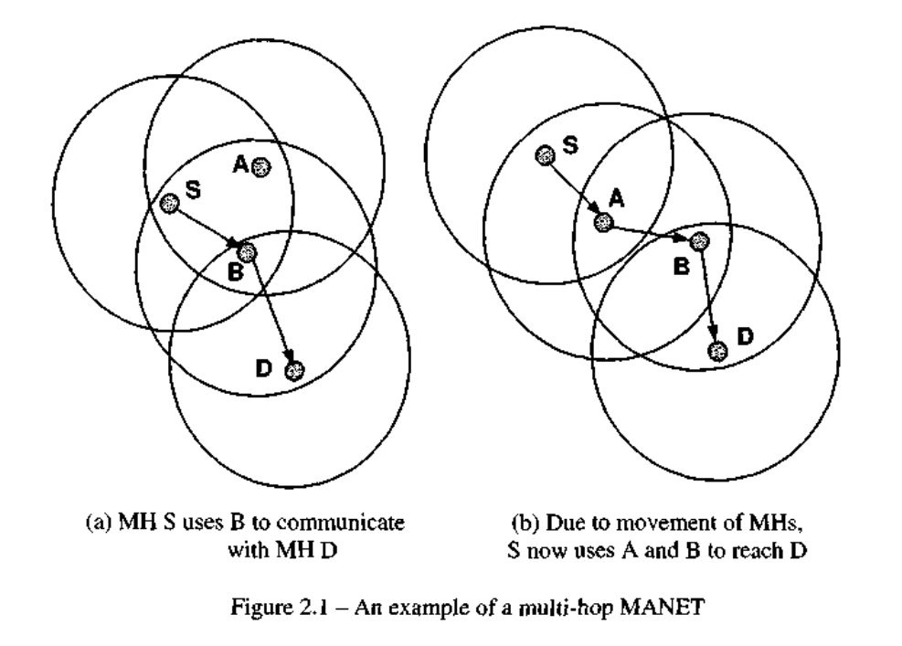
Routing in MANETS

Slide 12
Routing in MANETS
Many factors affecting routing in MANETs:
  Models of topology
  Selection of routers
  Initiation of route requests
  Specific underlying characteristics
    E.g. application-based characteristics
Major goals in selecting routing protocols:
  Provide the maximum possible reliability - use alternative routes if an intermediate node fails
  Choose a route with the least cost
    E.g., minimal # of hops from source to destination
  Give the nodes the best possible response time and throughput
  Each node in MANETs expected to serve as a router
    All execute the same routing protocol
      Protocol calculates a route

Slide 13
4.1. Need for Routing in MANETS
Goals for routing in MANETs:
  1) Route computation must be distributed
    Centralized routing in a dynamic network is usually too expensive
  2) Routing computation should not involve the maintenance of global state
    Would require exhibiting a lot of information in dynamic topology
  3) Each node must be only concerned about the routes to its destinations
  4) Stale routes must be avoided or detected & eliminated
  5) Broadcasts should be avoided
    Broadcasts can be highly unreliable in MANETs
  6) It is desirable to have a backup route
    Used when the primary route becomes stale

Slide 14
4.1. Need for Routing in MANETS – cont.
A major challenge in designing routing protocol:
  Must know at least how to route a packet via its neighbors
  Network topology can change frequently
  Large # of network nodes (MSs)
=> Could have a lot of info to update
    Unless a clever protocol design

Slide 15
4.2. Routing Classification
Types of routing protocols:
  1) Proactive protocols
    Keep routes ready at all times
      When a packet needs to be forwarded, the route is already known
    Example: distance vector routing protocols (more below)
  2) Reactive (= on-demand) protocols
    Route determination on demand
      Determine a route only when there is a packet to send
    Examples: flooding routing algorithms, ad hoc on-demand distance vector (AODV), temporarily ordered routing algorithm (TORA) (more below)
Proactive vs. reactive
  In proactive: a route available immediately
  In reactive: (1) a significant delay
  (2) significant traffic of control msgs
  (searching for a route)

Slide 16
13.4.2. Routing Classification – cont.
Is proactive or reactive better for MANETs?
  Pure proactive use too much bandwidth for control - updating routing information
    Too keep it current all the time
    But topology changes are so quick that most routes never used – a waste!
  Pure reactive too slow for real-time applications
(Orthogonal) types of routing protocols:
  1) Table-driven protocols
  2) Source-initiated on-demand protocols
  3) Hybrid protocls
More on all of them in the following subsections

Slide 17
5. Table-driven Routing Protocols
“Table-driven” because:
Each node maintains table(s) with routing information for every other nodes in the network
Table-driven is proactive
  When the topology changes, updates are propagated throughout the network.
Examples of table-driven routing protocols are:
  Destination Sequenced Distance Vector routing (DSDV)
  Cluster-head Gateway Switch routing (CGSR)
  Wireless Routing Protocol (WRP)

Slide 18
++SKIP++ 13.5.1. Destination-Sequenced
Distance-Vector Routing (DSDV)
Based on the Bellman-Ford algorithm (skipped – Ch.12)
Each mobile node maintains a routing table
  In terms of number of hops to each destination
Routing table updates are periodically transmitted
Each entry in the table is marked by a sequence number
  Helps to distinguish stale routes from new ones, and thereby avoiding loops
To minimize the routing updates, variable sized update packets are used
  Depending on the number of topological changes

Slide 19
13.5.2. Cluster-head Gateway Switch Routing (CGSR)
Cluster-head gateway switch routing (CGSR) –
a clustered multi-hop routing, heuristic
MANET divided into clusters
  For each cluster, a cluster-head (CH) elected
    By a distributed CH selection algorithm
        It modifies DSDV by using a hierarchical CH to route traffic
  Gateway nodes are bridges connecting cluster heads
Frequent changes of CHs affect the performance
Gateway Node
Cluster Head
7
10
Internal (non-cluster) Node
8
9

Slide 20
13.5.2. Cluster Head Gateway Switch Routing (CGSR)
CGSR scenario - routing from Node 1 to Node 12:
  Packet sent by Node 1 is first routed to its CH (2)
  The packet is routed from CH (2) to gateway (4) connecting to CH of another cluster (5)
  Packet routed from gateway (4) to the next CH (5)
  …
  Packet routed from gateway (10) to CH of destination cluster (11)
  Packet routed to destination node (12)
6
12
5
11
4
7
10
2
1
9
8
Gateway Node
3
Cluster Head
Internal (non-cluster) Node

Slide 21
++SKIP++ 13.5.3. The Wireless Routing Protocol (WRP)
Each node maintains 4 tables:
  Distance table
  Routing table
  Link cost table
  Message Retransmission List table (MRL)
  MRL contains the sequence number of the update message, a retransmission counter and a list of updates sent in the update message

Slide 22
++SKIP++ 13.5.3. The Wireless Routing Protocol (WRP) – cont.
Nodes inform each other of link changes using update messages
Nodes send update messages after processing updates from their neighbors or after detecting a change in the link
If a node is not sending messages, it must send a HELLO message within a specified time to ensure connectivity
If the node receives a HELLO message from a new node, that node is added to the table
It avoids the “count to infinity” problem

Slide 23
13.6. Source-Initiated On-Demand Routing (the second category of routing protocols)
Source-initiated on-demand routing - the 2nd category (“family”) of routing protocols
This family of protocols includes:
  Ad hoc On-Demand Distance Vector (AODV)
  Dynamic Source Routing (DSR)
  Temporary Ordered Routing Algorithm (TORA)
  Associativity Based Routing (ABR)
  Signal Stability Routing (SSR)

Slide 24
++SKIP++ 13.6.1. Ad hoc On-Demand Distance Vector Routing
AODV is an improvement over DSDV, which minimizes the number of required broadcasts by creating routes on demand
Nodes that are not in a selected path do not maintain routing information or participate in routing table exchanges
A source node initiates a path discovery process to locate the other intermediate nodes (and the destination), by broadcasting a Route Request (RREQ) packet to its neighbors

Slide 25
++SKIP++ Route Discovery in AODV Protocol
Hop1
Hop2
Hop3
2
7
Source
5
1
8
3
Destination
6
4
(a) Propagation of Route Request (RREQ) Packet
7
2
1
5
Source
8
Destination
3
4
6
(b) Path Taken by the Route Reply (RREP) Packet

Slide 26
++SKIP++ 13.6.2. Dynamic Source Routing
The protocol consists of two major phases: Route Discovery, Route Maintenance
When a mobile node has a packet to send to some destination, it first consults its route cache to check whether it has a route to that destination
If it is an un-expired route, it will use this route
If the node does not have a route, it initiates route discovery by broadcasting a Route Request packet
This Route Request contains the address of the destination, along with the source address

Slide 27
++SKIP++ 13.6.2. Dynamic Source Routing – cont. 1
  Each node receiving the packet checks to see whether it has a route to the destination. If it does not, it adds its own address to the route record of the packet and forwards it.
  A route reply is generated when the request reaches either the destination itself or an intermediate node that contains in its route cache an un-expired route to that destination.
  If the node generating the route reply is the destination, it places the the route record contained in the route request into the route reply.

Slide 28
++SKIP++ 13.6.2. Dynamic Source Routing – cont. 2
Creation of Route Record in DSR
Hop1
Hop2
7
Hop3
Hop4
7
<1>
2
<1,2>
<1,3,5,7>
Source
5
<1,3,5>
1
1
<1>
8
Destination
3
3
<1,3>
<1>
<1,4,6>
4
6
4
<1,4>
(a) Building Record Route During Route Discovery
2
7
Source
1
5
3
8
Destination
<1,4,6>
6
<1,4,6>
4
<1,4,6>
(b) Propagation of Route Reply with the Route Record

Slide 29
++SKIP++ 13.6.3. Temporarily Ordered Routing Algorithm (TORA)
TORA is a highly adaptive loop-free distributed routing algorithm based on the concept of link reversal
TORA decouples the generation of potentially far-reaching control messages from the rate of topological changes
The height metric is used to model the routing state of the network

Slide 30
Illustration of Tora height metric
++SKIP++ 13.6.3. TORA – cont. 1
Source
H = 3
H = 2
H = 1
H = 0
Destination

Slide 31
++SKIP++ 13.6.3. TORA – cont. 2
The protocol performs three basic functions: route creation, route maintenance, route erasure
During the route creation and maintenance phases nodes use a height metric to establish a Directed Acyclic Graph (DAG) rooted at the destination
Thereafter links are assigned a direction based on the relative heights

Slide 32
++SKIP++ 13.6.3 13.6.3. TORA – cont. 3
2
7
(-,-)
5
(-,-)
(-,-)
Destination
Source
1
3
8
(-,-)
(-,-)
(0,0)
6
4
(-,-)
(-,-)
Figure 13.6(a) – Propagation of the query message
2
7
(0,3)
5
(0,1)
Source
(0,2)
Destination
1
3
8
(0,3)
(0,3)
(0,0)
6
4
(0,1)
(0,2)
Node’s height updated as a result of the update message

Slide 33
13.7. Hybrid routing protocols
Many of hybrid routing protocols
7 example protocols follow

Slide 34
++SKIP++ 13.7. Hybrid routing protocols – cont. 1
1) Zone Routing Protocol (ZRP): A node proactively maintains routes to destinations within a local neighborhood
  The construction of a routing zone requires a node to first know who its neighbor, which is implemented through a MAC layer Neighbor Discovery Protocol
2) Fisheye State Routing (FSR): There are multi-level fisheye scopes to reduce routing update overhead in large networks
  It helps to make a routing protocol scalable by gathering data on the topology, which may be needed soon
3) Landmark Routing (LANMAR): Uses a landmark to keep track of a logical subnet
  The LANMAR routing table includes only those nodes within the scope and the landmark nodes themselves

Slide 35
++SKIP++ 13.7. Hybrid routing protocols – cont. 2
4) Location-Aided Routing (LAR): Exploits location information to limit the scope of routing
  LAR limits the search based on the expected location of the destination node and thereby restricts and controls the flood of Route Request packets
5) Distance Routing Effect Algorithm for Mobility (DREAM) : Based on the distance effect and a node’s mobility rate
  Each node can optimize the frequency at which it sends updates to the networks and correspondingly reduce the bandwidth and energy used
6) Relative Distance Micro-discovery Ad Hoc Routing (RDMAR): Based on the calculated relative distance between two terminals
  The query flood is localized to a limited region centered at the source node

Slide 36
++SKIP++ 13.7. Hybrid routing protocols – cont. 3
7) Power Aware Routing: Power-aware metrics are used for determining routes
  It reduces the cost, ensures that the mean time to node failure is increased, without any further delay in packet delivery

Slide 37
++SKIP++ 13.7.7B. Summary of Some Characteristics of Selected Protocols
Pro-tocol | Route Acquisi-tion | Flood for Route Discovery | Delay for Route Discovery | Multipath Capability | Effect of Route Failure
DSDV | Computed a priori | No | No | No | Updates the routing tables of all nodes
WRP | Computed a priori | No | No | No | Ultimately, updates the routing tables of all nodes by exchanging MRL between neighbors
DSR | On-demand, only when needed | Yes. Aggressive use of caching may reduce flood | Yes | Not explicitly. The technique of salvaging may quickly restore a route | Route error propagated up to the source to erase invalid path

Slide 38
Summary of Some Characteristics of Selected Protocols – cont.
Pro-tocol | Route Acquisi-tion | Flood for Route Discovery | Delay for Route Discovery | Multipath Capability | Effect of Route Failure
AODV | On-demand, only when needed | Yes. Controlled use of cache to reduce flood | Yes | No, although recent research indicate viability | Route error propagated up to the source to erase invalid path
TORA | On-demand, only when needed | Basically one for initial route discovery | Yes. Once the DAG is constructed, multiple paths are found | Yes | Error is recovered locally
LAR | On-demand, only when needed | Reduced by using location information | Yes | No | Route error propagated up to the source
ZRP | Hybrid | Only outside a source's zone | Only if the destination is outside the source's zone | No | Hybrid of updating nodes' tables within a zone and propagating route error to the source

